Slide 1
My portfolio
STUDENT NAME: KANIMOZHI.H
REGISTER NO AND NMID:
DEPARTMENT: BSC COMPUTER SCIENCE
COLLEGE/UNIVERSITY: TAGORE COLLEGE OF ARTS&SCIENCE/ MADRAS UNIVERSITY

Slide 2
PROJECT TITLE
My Portfolio
About me, Education, Skills, Projects, Hobbies, Contact
A personal website designed to showcase my skills, projects and hobbies.

Slide 3
AGENDA
Problem statement
Project Overview
End Users
Tools and Technologies
Portfolio design and Layout
Features and Functionality
Results and Screenshots
Conclusion
GitHub Link

Slide 4
PROBLEM STATEMENT
Students often struggle to present their skills in a structured way. A digital portfolio helps organize education, skills, projects, and hobbies in a professional format.

Slide 5
PROJECT OVERVIEW
This project is a Digital Portfolio created to showcase my education, skills, projects, and hobbies. It was developed using simple design tools and coding, with the goal of presenting my profile in a clear and professional way.

Slide 6
WHO ARE THE END USERS
The end users are teachers, recruiters, and peers who wish to view my education, skills, projects, hobbies in a structured way.

Slide 7
TOOLS AND TECHNIQUES
Frontend: HTML, CSS
Images: Canva
Editor: VS Code/Notepad++
Hosting: GitHub Pages

Slide 8
portfolio DESIGN AND LAYOUT
The Portfolio follows a clean and minimal design with soft colors and readable fonts. The layout includes sections such as About Me, Education, Skills, Projects, Hobbies, and Contact. A simple grid style is used for organizing content neatly.

Slide 9
FEATURES AND FUNCTIONATILY
The portfolio includes easy navigation between sections such as About Me, Education, Skills, Projects, Hobbies and Contact. It supports images, icons, and interactive elements for better presentation. The Layout is simple, user-friendly, and can be accessed across devices.

Slide 10
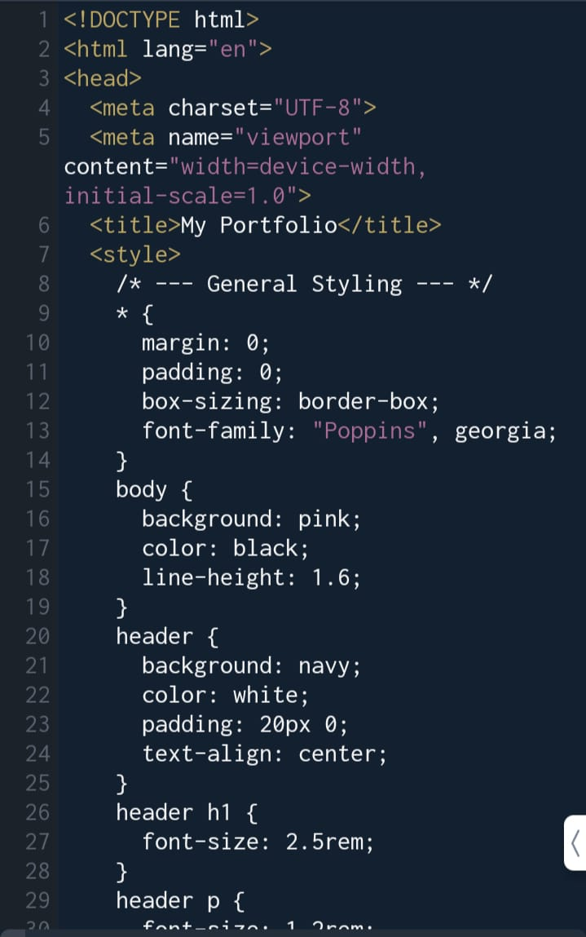
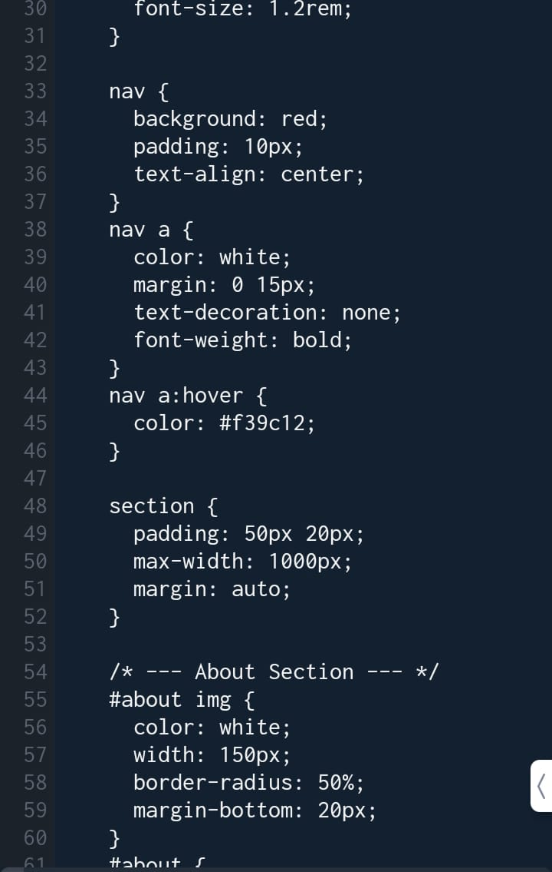
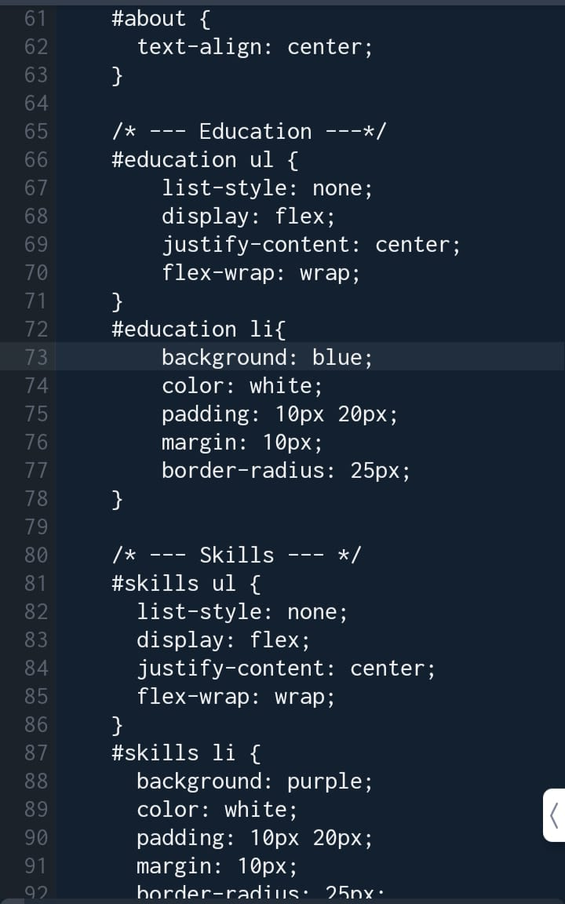
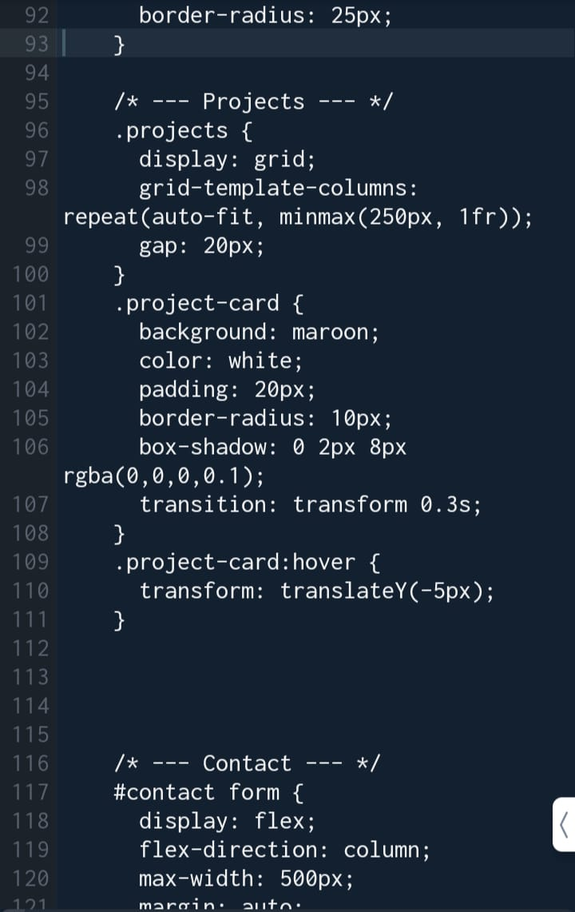
Coding and screenshots

Slide 11
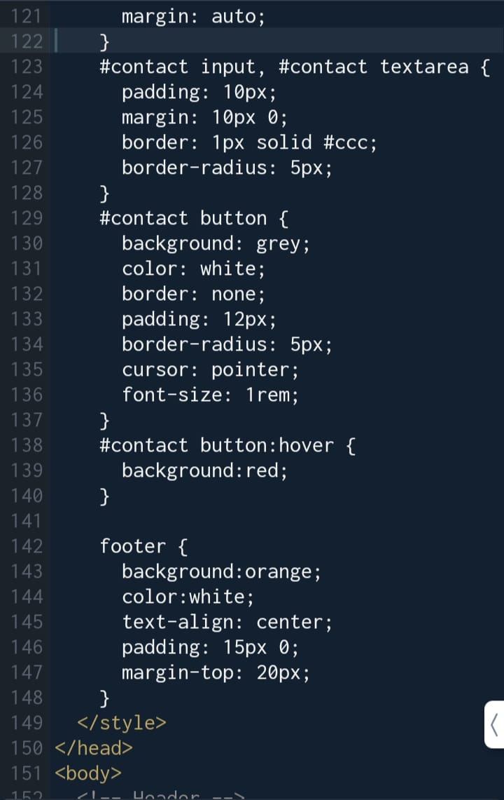
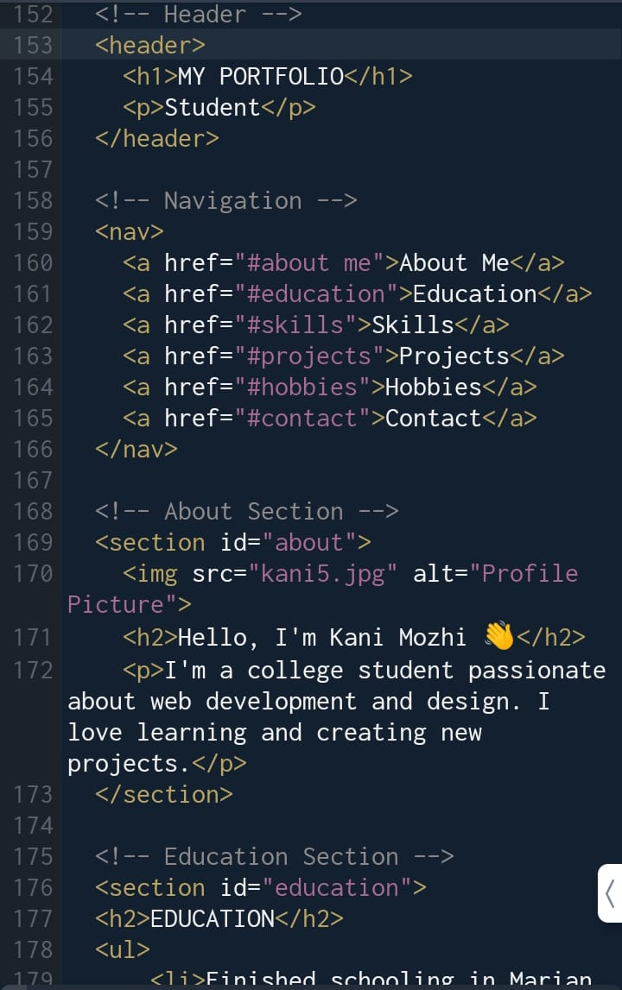
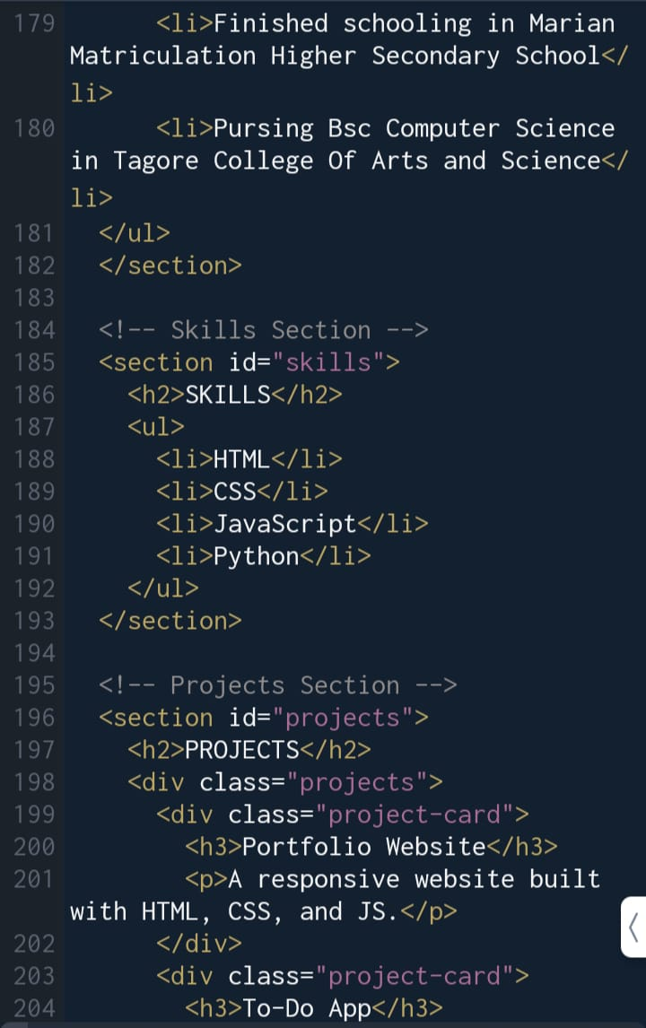

Slide 12
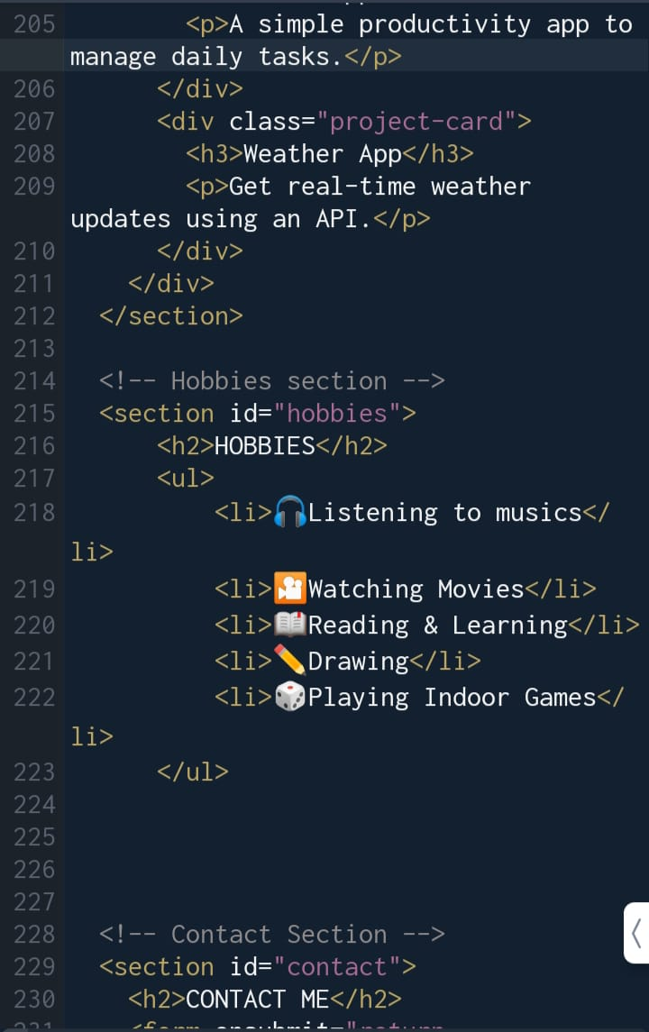
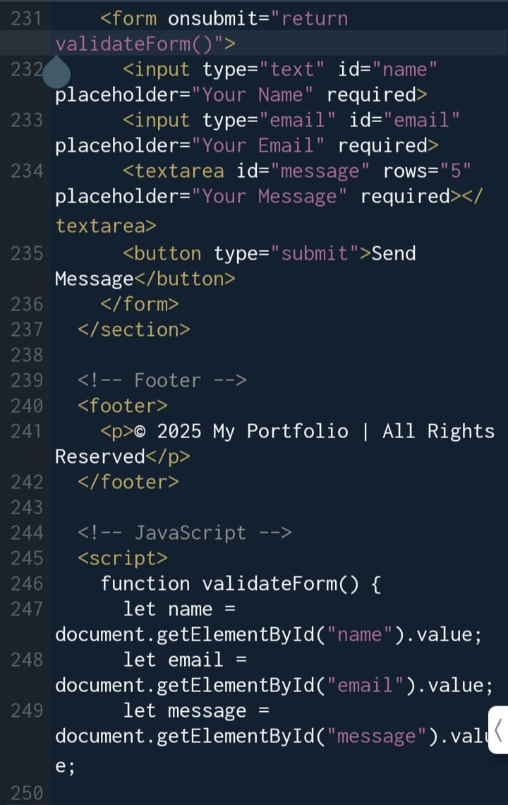
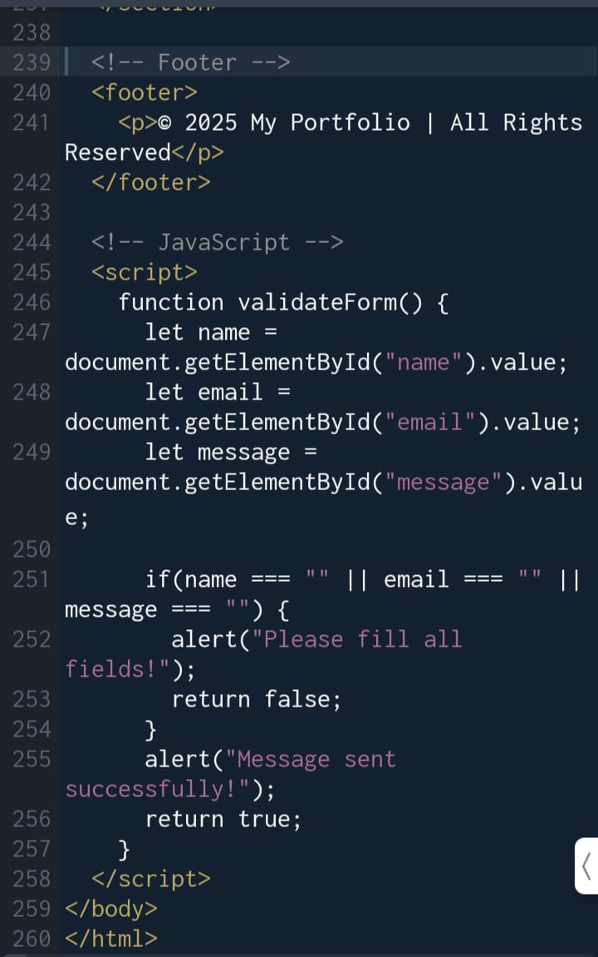

Slide 13
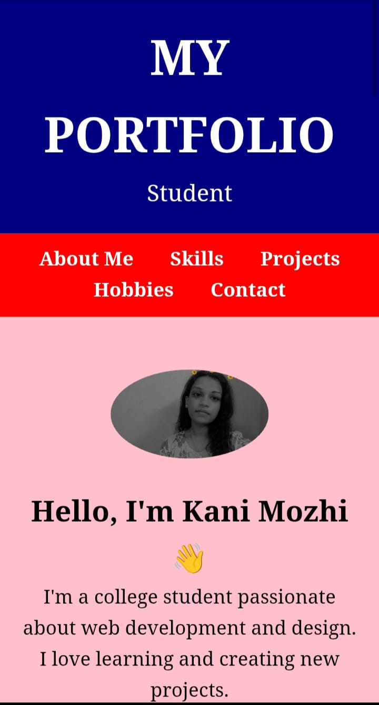
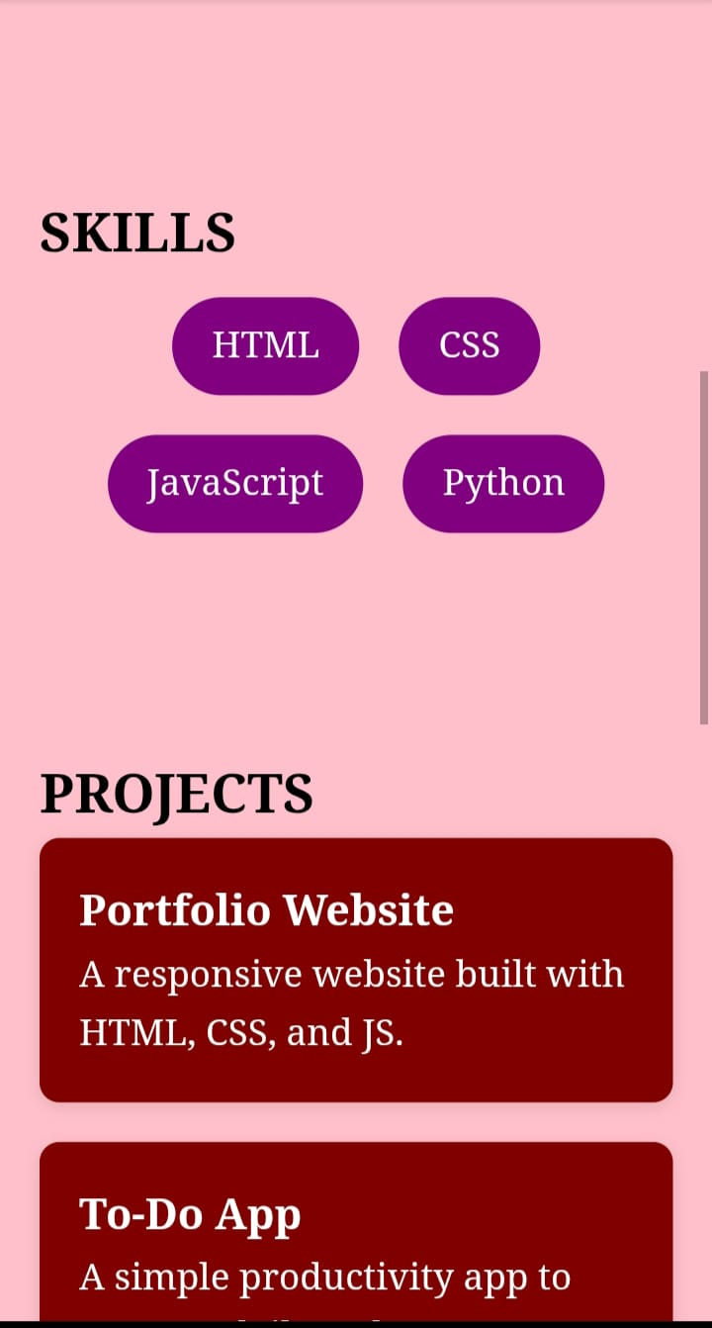
RESULTS AND SCREENSHOTS

Slide 14
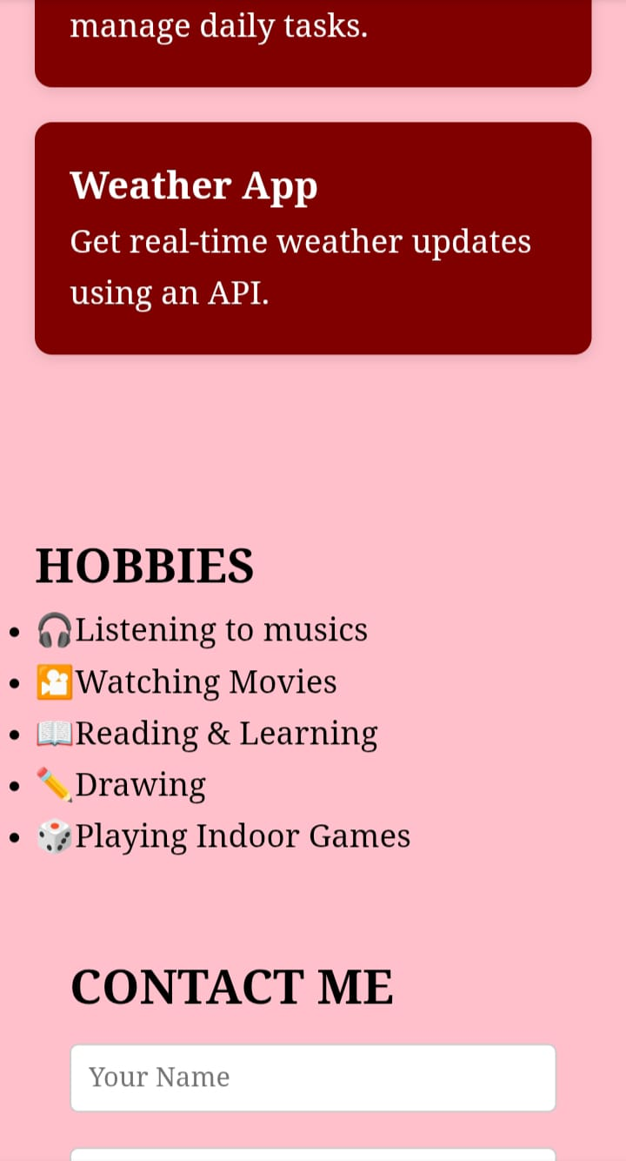
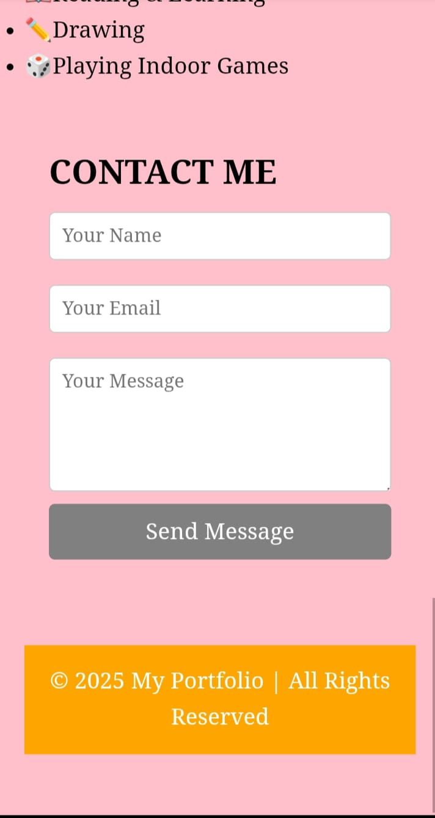

Slide 15
CONCULSION
This project helped me create a structured and professional portfolio to showcase my education, skills, and hobbies. Through this, I gained hands-on experience in design and presentation. In the future, I plan to enhance it with more interactive features and keep updating it with new projects.

Slide 16
GITHUB LINK

